Slide 1
Chapter 12
Iterative Methods for System of Equations

Slide 2
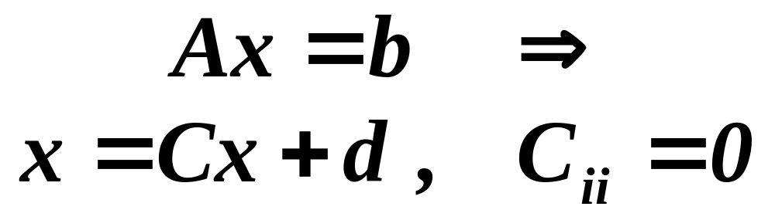
Iterative Methods for Solving Matrix Equations
Jacobi method
Gauss-Seidel Method*
Successive Over Relaxation (SOR)
MATLAB’s Methods

Slide 3
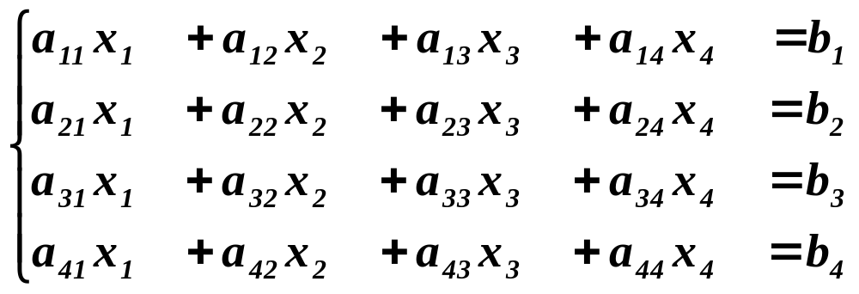
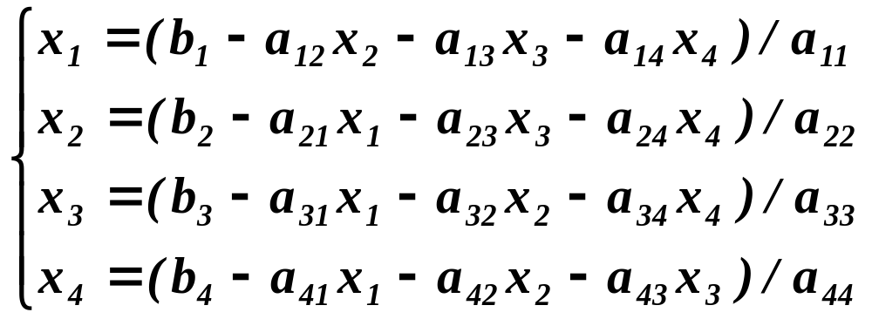
Iterative Methods
Can be converted to

Slide 4
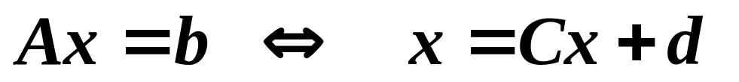
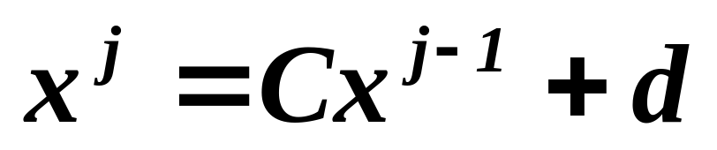
Iterative Methods
Idea behind iterative methods:
Convert Ax = b into x = Cx +d
Generate a sequence of approximations (iteration) x¹, x², …., with initial x⁰
Similar to fix-point iteration method
Equivalent system

Slide 5
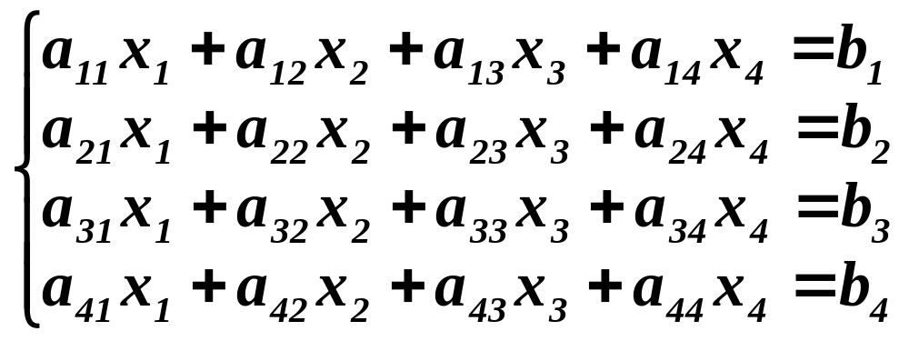
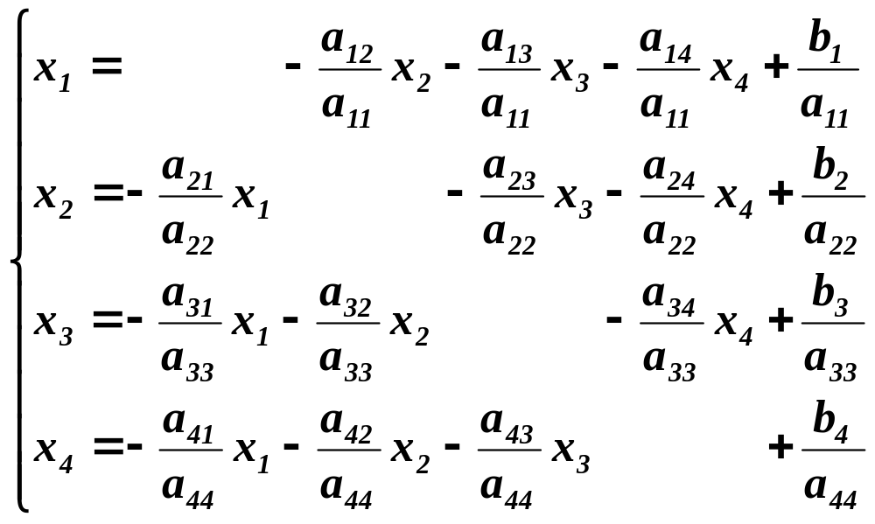
Rearrange Matrix Equations
Rewrite the matrix equation in the same way
n equations
n variables

Slide 6
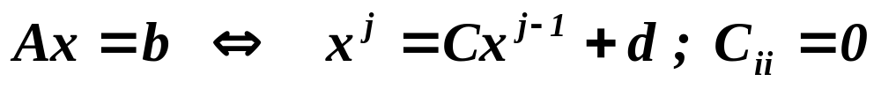
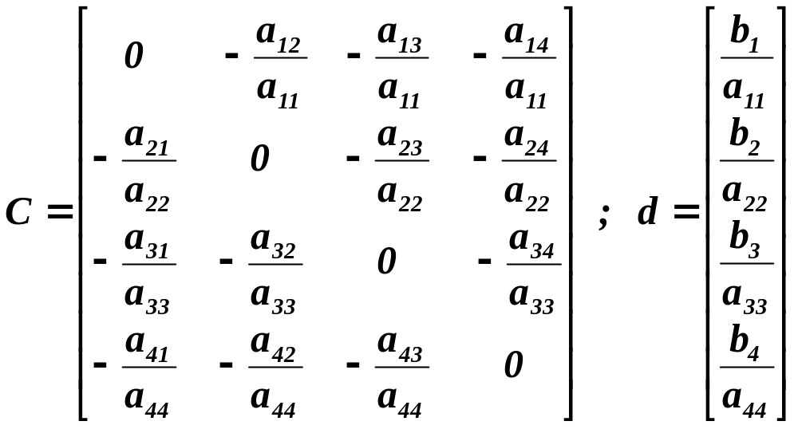
Iterative Methods
x and d are column vectors, and C is a square matrix

Slide 7
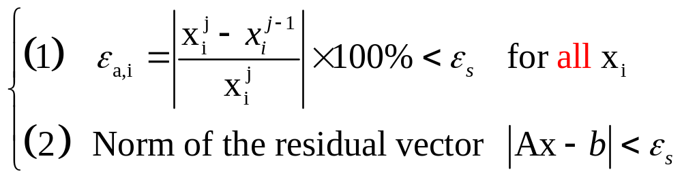
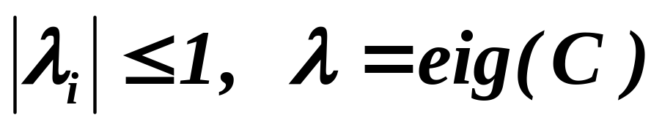
Convergence Criterion
For system of equations

Slide 8
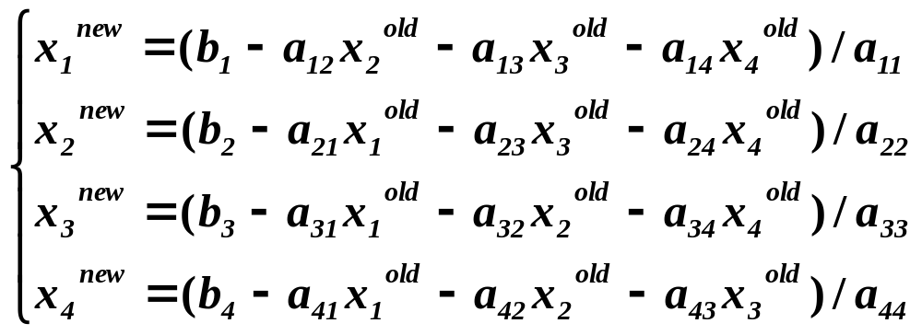
Jacobi Method

Slide 9
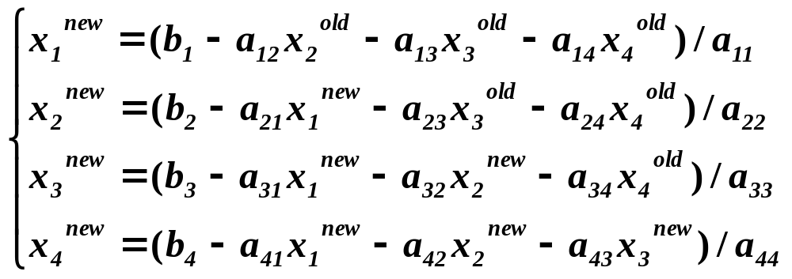
Gauss-Seidel Method
Differ from Jacobi method by sequential updating: use new x_{i} immediately as they become available

Slide 10
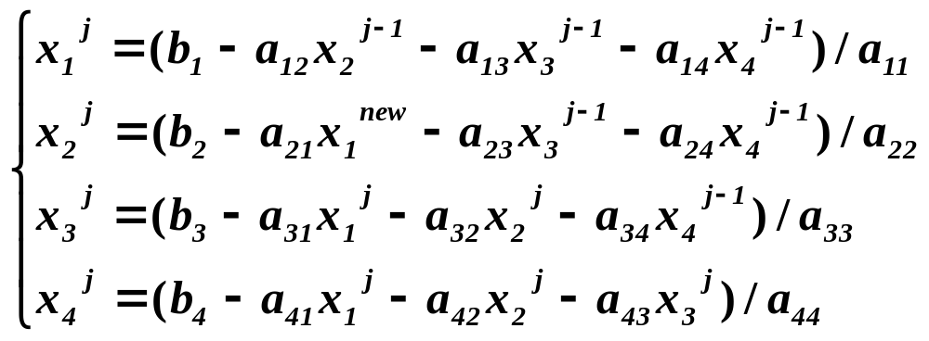
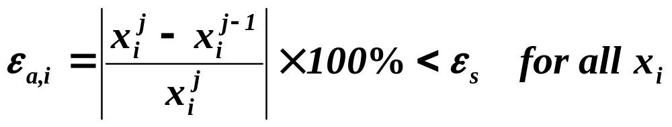
Gauss-Seidel Method
use new x_{i} at j^{th} iteration as soon as they become available

Slide 11
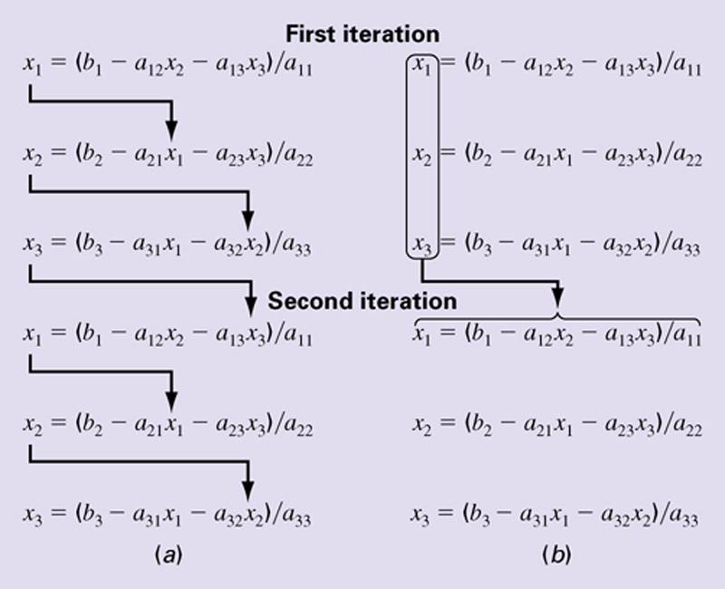
(a) Gauss-Seidel Method (b) Jacobi Method

Slide 12
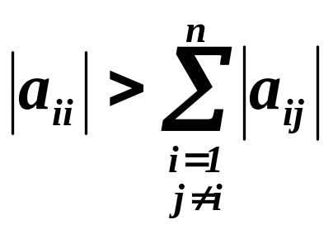
Convergence and Diagonal Dominant
Sufficient condition -- A is diagonally dominant
Diagonally dominant: the magnitude of the diagonal element is larger than the sum of absolute value of the other elements in the row
Necessary and sufficient condition -- the magnitude of the largest eigenvalue of C (not A) is less than 1
Fortunately, many engineering problems of practical importance satisfy this requirement
Use partial pivoting to rearrange equations!

Slide 13
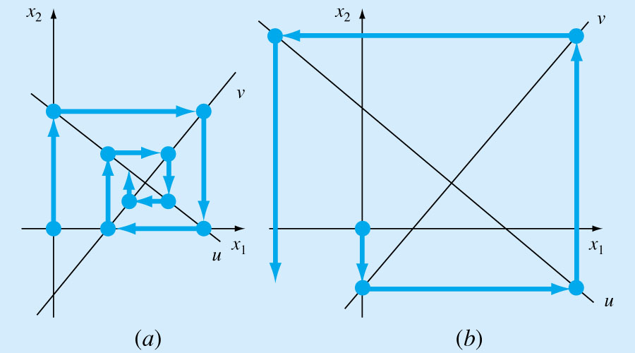
Convergence or Divergence of Jacobi and Gauss-Seidel Methods
Same equations, but in different order
Rearrange the order of the equations to ensure convergence

Slide 14
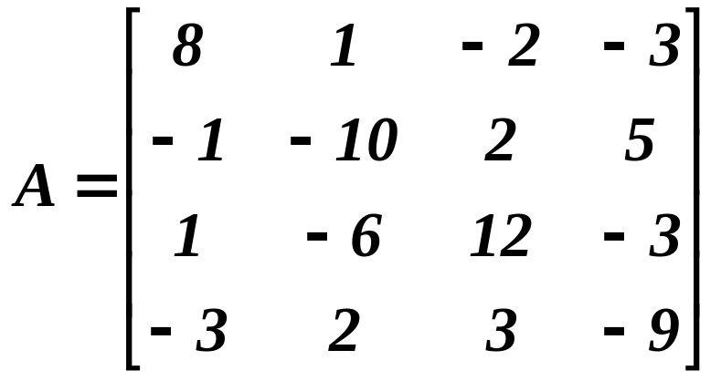
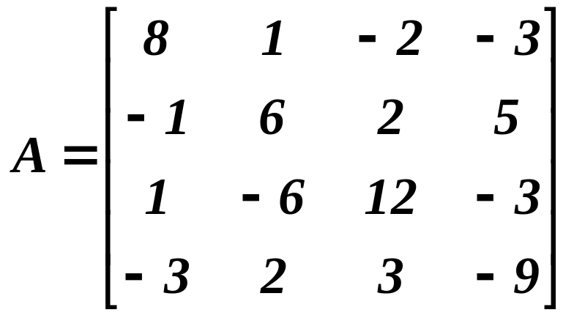
Diagonally Dominant Matrix
is strictly diagonally dominant because diagonal elements are greater than sum of absolute value of other elements in row
is not diagonally dominant

Slide 15
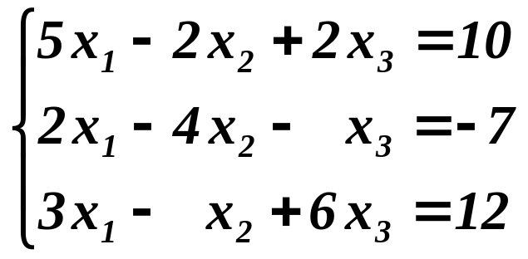
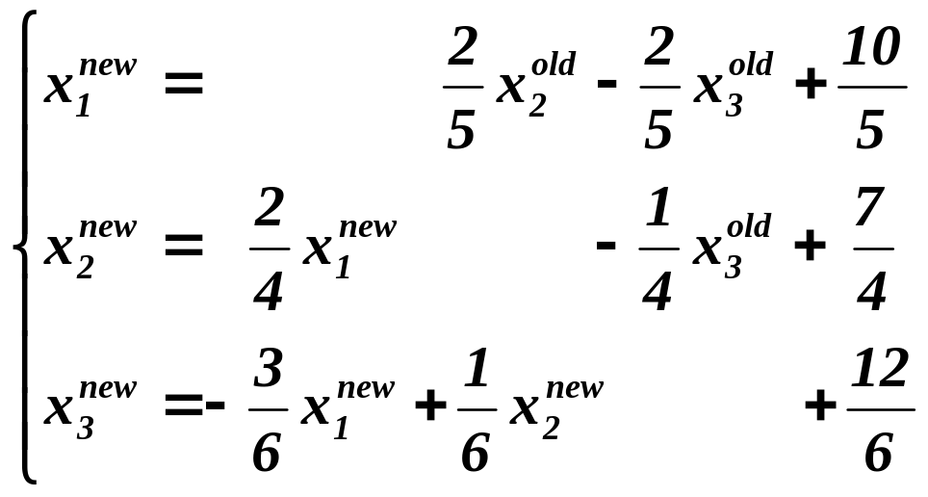
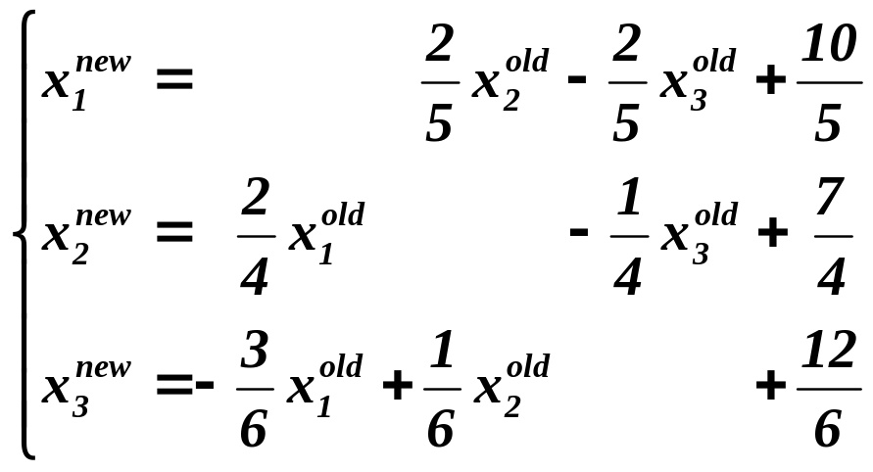
Jacobi and Gauss-Seidel
Example:
Jacobi
Gauss-Seidel

Slide 16
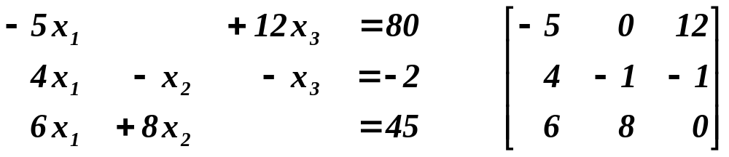
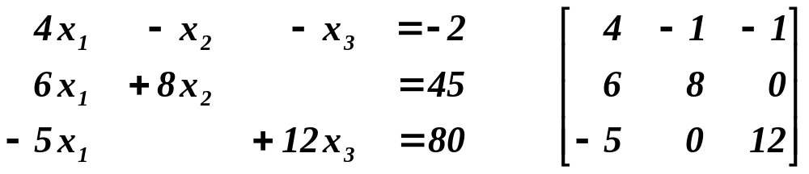
Example
Not diagonally dominant !!
Order of the equation can be important
Rearrange the equations to ensure convergence

Slide 17
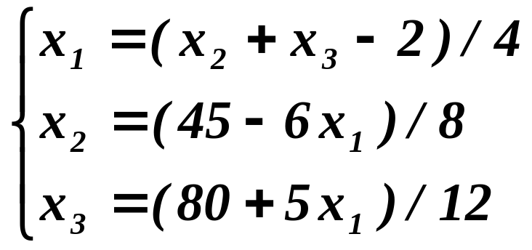
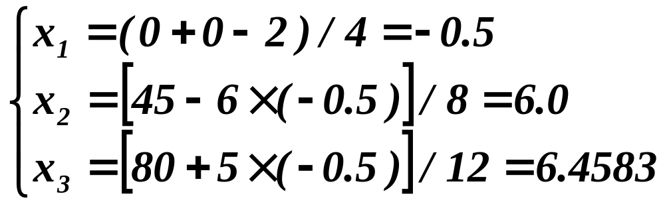
Gauss-Seidel Iteration
Rearrange
Assume x₁ = x₂ = x₃ = 0
First iteration

Slide 18
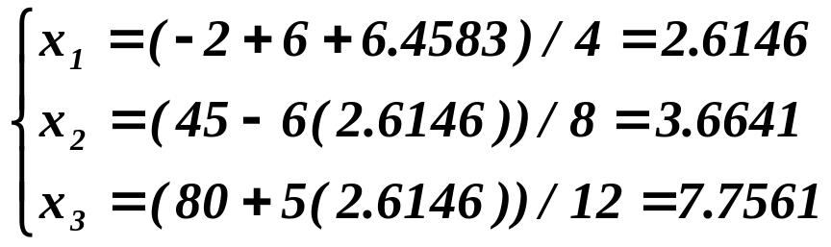
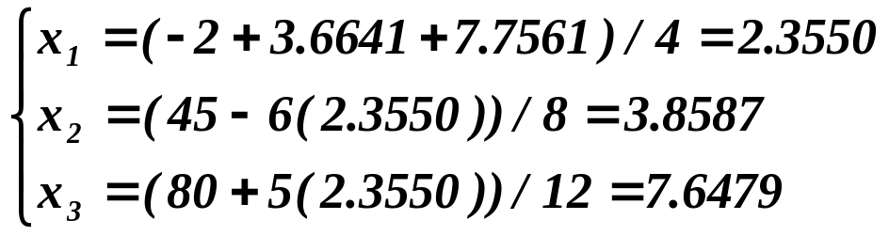
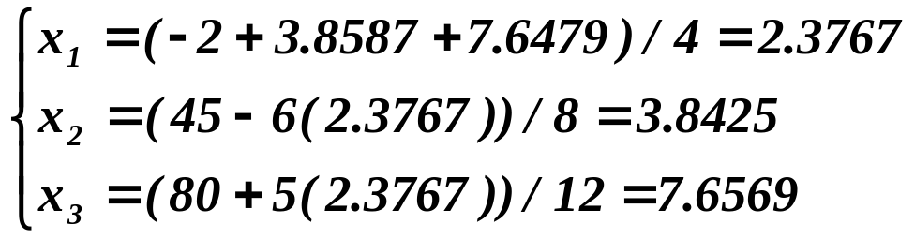
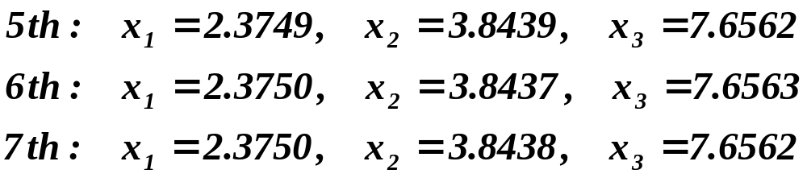
Gauss-Seidel Method
Second iteration
Third iteration
Fourth iteration

Slide 19

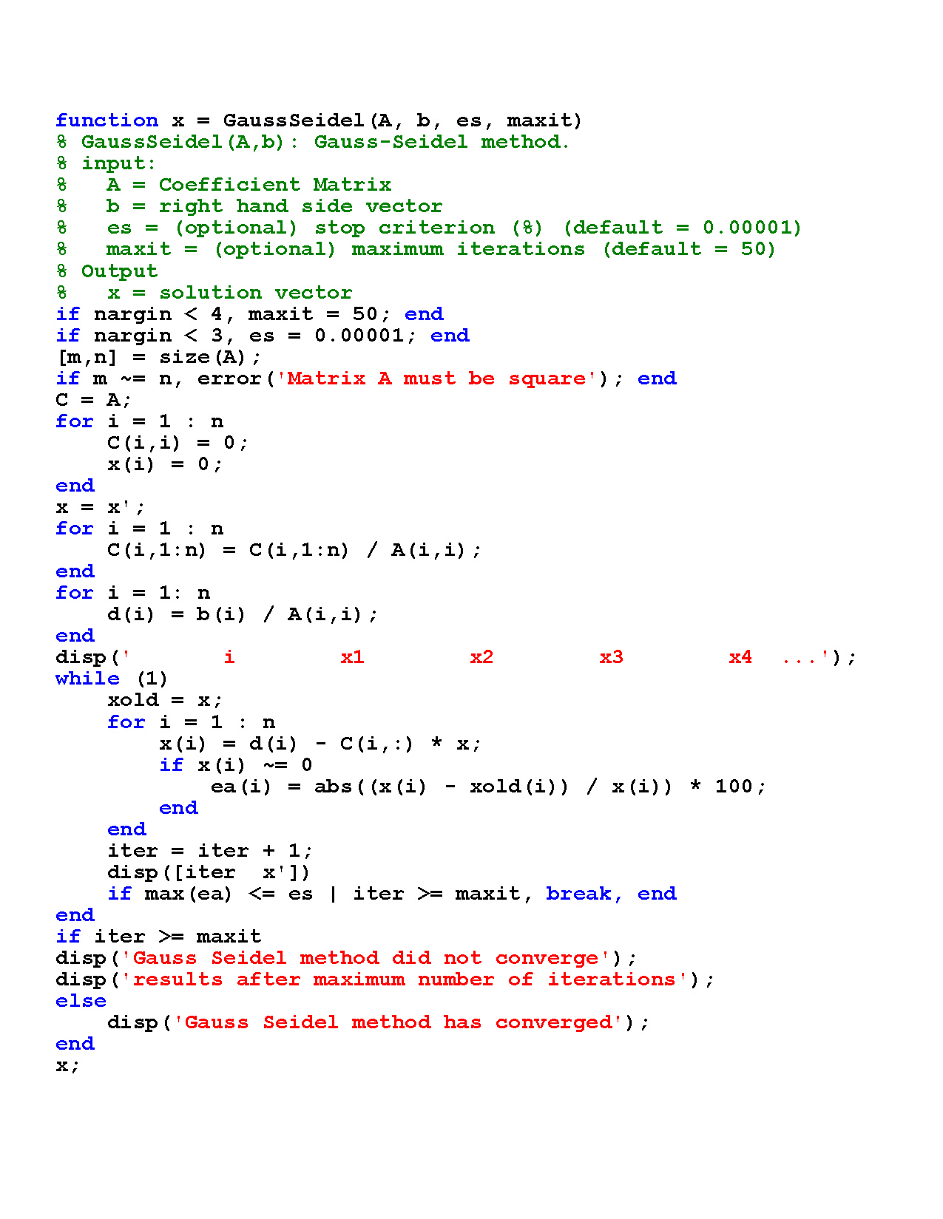
MATLAB M-File for Gauss-Seidel method
Continued on next page

Slide 20
MATLAB M-File for Gauss-Seidel method
Continued from previous page

Slide 21
Gauss-Seidel Iteration
» A = [4 –1 –1; 6 8 0; -5 0 12];
» b = [-2 45 80];
» x=Seidel(A,b,x0,tol,100);
i x1 x2 x3 x4 ....
1.0000 -0.5000 6.0000 6.4583
2.0000 2.6146 3.6641 7.7561
3.0000 2.3550 3.8587 7.6479
4.0000 2.3767 3.8425 7.6569
5.0000 2.3749 3.8439 7.6562
6.0000 2.3750 3.8437 7.6563
7.0000 2.3750 3.8438 7.6562
8.0000 2.3750 3.8437 7.6563
Gauss-Seidel method converged
Converges faster than the Jacobi method shown in next page

Slide 22
Jacobi Iteration
» A = [4 –1 –1; 6 8 0; -5 0 12];
» b = [-2 45 80];
» x=Jacobi(A,b,0.0001,100);
i x1 x2 x3 x4 ....
1.0000 -0.5000 5.6250 6.6667
2.0000 2.5729 6.0000 6.4583
3.0000 2.6146 3.6953 7.7387
4.0000 2.3585 3.6641 7.7561
5.0000 2.3550 3.8561 7.6494
6.0000 2.3764 3.8587 7.6479
7.0000 2.3767 3.8427 7.6568
8.0000 2.3749 3.8425 7.6569
9.0000 2.3749 3.8438 7.6562
10.0000 2.3750 3.8439 7.6562
11.0000 2.3750 3.8437 7.6563
12.0000 2.3750 3.8437 7.6563
13.0000 2.3750 3.8438 7.6562
14.0000 2.3750 3.8438 7.6562
Jacobi method converged

Slide 23
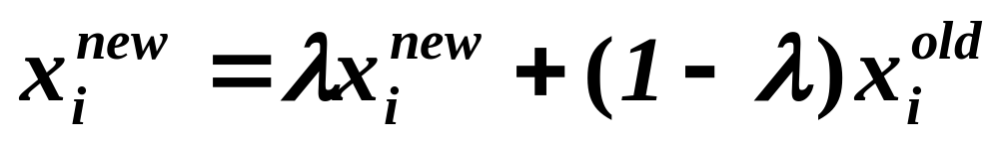
Relaxation Method
Relaxation (weighting) factor λ
Gauss-Seidel method: λ = 1
Overrelaxation 1 < λ < 2
Underrelaxation 0 < λ < 1
Successive Over-relaxation (SOR)

Slide 24

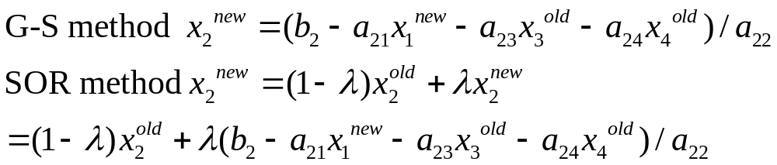
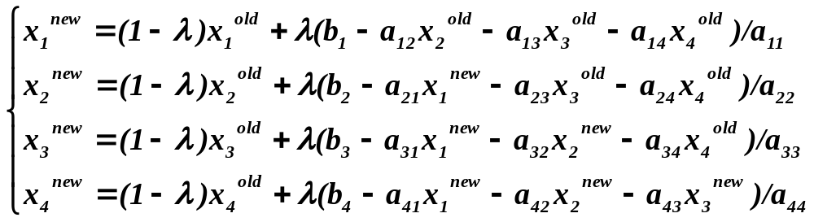
Successive Over Relaxation (SOR)
Relaxation method

Slide 25
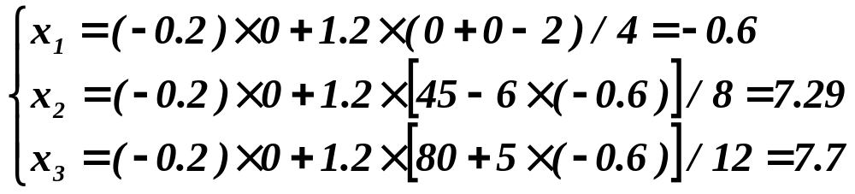
SOR Iterations
Rearrange
Assume x₁ = x₂ = x₃ = 0, and λ = 1.2
First iteration

Slide 26
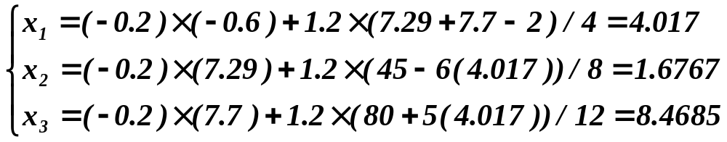
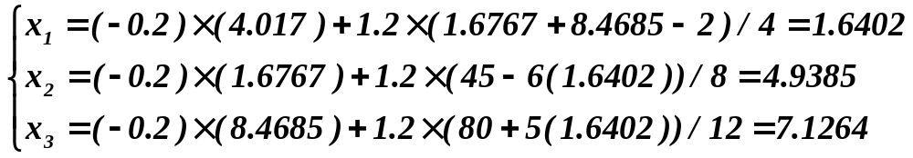
SOR Iterations
Second iteration
Third iteration
Converges slower !! (see MATLAB solutions)
There is an optimal relaxation parameter

Slide 27
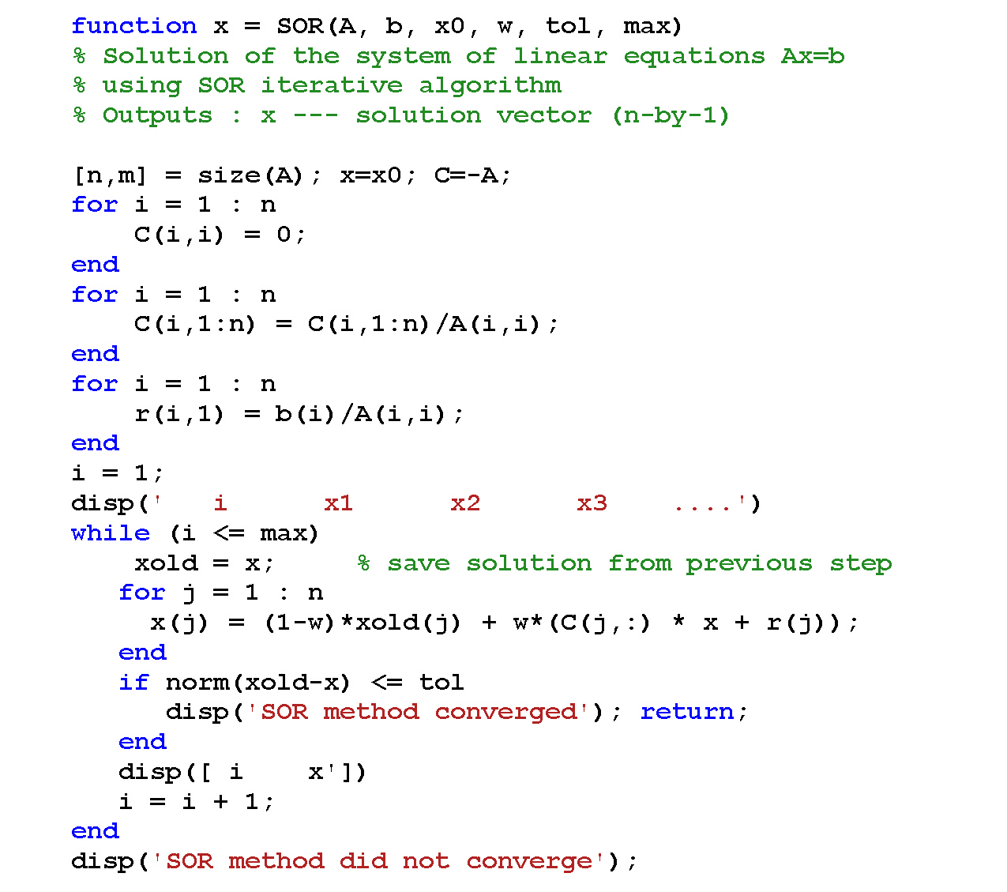
Successive Over Relaxation
Relaxation factor w (= λ)

Slide 28
SOR with λ = 1.2
» [A,b]=Example
A =
4 -1 -1
6 8 0
-5 0 12
b =
-2
45
80
» x0=[0 0 0]'
x0 =
0
0
0
» tol=1.e-6
tol =
1.0000e-006
» w=1.2; x = SOR(A, b, x0, w, tol, 100);
i x1 x2 x3 ....
1.0000 -0.6000 7.2900 7.7000
2.0000 4.0170 1.6767 8.4685
3.0000 1.6402 4.9385 7.1264
4.0000 2.6914 3.3400 7.9204
5.0000 2.2398 4.0661 7.5358
6.0000 2.4326 3.7474 7.7091
7.0000 2.3504 3.8851 7.6334
8.0000 2.3855 3.8261 7.6661
9.0000 2.3705 3.8513 7.6521
10.0000 2.3769 3.8405 7.6580
11.0000 2.3742 3.8451 7.6555
12.0000 2.3753 3.8432 7.6566
13.0000 2.3749 3.8440 7.6561
14.0000 2.3751 3.8436 7.6563
15.0000 2.3750 3.8438 7.6562
16.0000 2.3750 3.8437 7.6563
17.0000 2.3750 3.8438 7.6562
18.0000 2.3750 3.8437 7.6563
19.0000 2.3750 3.8438 7.6562
20.0000 2.3750 3.8437 7.6563
21.0000 2.3750 3.8438 7.6562
SOR method converged
Converge Slower !!

Slide 29
SOR with λ = 1.5
» [A,b]=Example2
A =
4 -1 -1
6 8 0
-5 0 12
b =
-2
45
80
» x0=[0 0 0]'
x0 =
0
0
0
» tol=1.e-6
tol =
1.0000e-006
» w = 1.5; x = SOR(A, b, x0, w, tol, 100);
i x1 x2 x3 ....
1.0000 -0.7500 9.2812 9.5312
2.0000 6.6797 -3.7178 9.4092
3.0000 -1.9556 12.4964 4.0732
4.0000 6.4414 -5.0572 11.9893
5.0000 -1.3712 12.5087 3.1484
6.0000 5.8070 -4.3497 12.0552
7.0000 -0.7639 11.4718 3.4949
8.0000 5.2445 -3.1985 11.5303
9.0000 -0.2478 10.3155 4.0800
10.0000 4.7722 -2.0890 10.9426
11.0000 0.1840 9.2750 4.6437
12.0000 4.3775 -1.1246 10.4141
13.0000 0.5448 8.3869 5.1335
14.0000 4.0477 -0.3097 9.9631
15.0000 0.8462 7.6404 5.5473
………
20.0000 3.3500 1.4220 9.0016
………
30.0000 2.7716 2.8587 8.2035
………
50.0000 2.4406 3.6808 7.7468
………
100.0000 2.3757 3.8419 7.6573
SOR method did not converge
Diverged !!

Slide 30
CVEN 302-501
Homework No. 8
Chapter 12
Prob. 12.4 & 12.5 (Hand calculation and check the results using the programs)
You do it but do not hand in. The solution will be posted on the net.

Slide 31
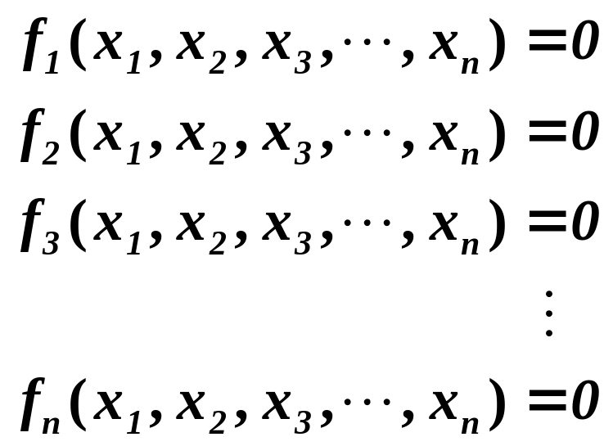
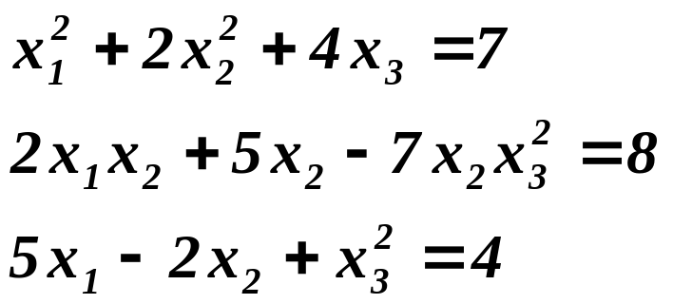
Nonlinear Systems
Simultaneous nonlinear equations
Example

Slide 32
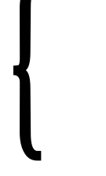
Two Nonlinear Functions
Circle x² + y² = r²
f(x,y)=0
g(x,y)=0
Solution depends on initial guesses
Ellipse (x/a)² + (y/b)² = 1

Slide 33
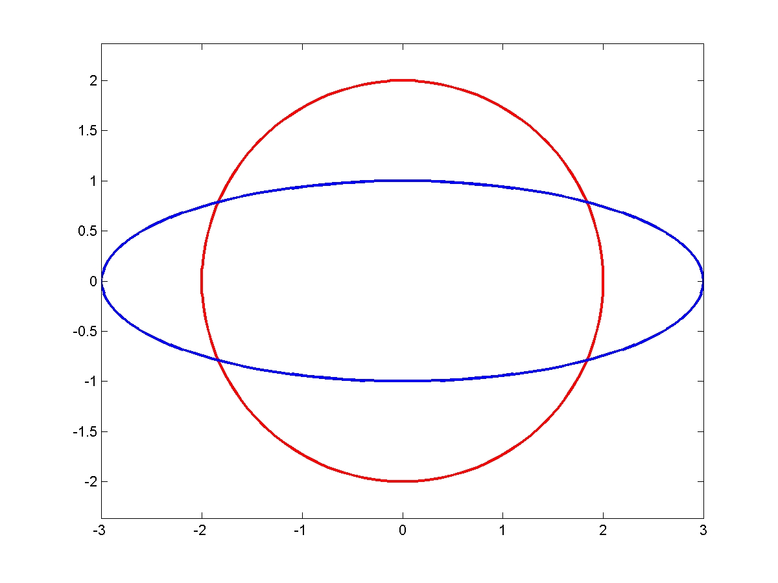
function [x1,y1,x2,y2]=curves(r,a,b,theta)
% Circle with radius A
x1=r*cos(theta); y1=r*sin(theta);
% Ellipse with major and minor axes (a,b)
x2=a*cos(theta); y2=b*sin(theta);
» r=2; a=3; b=1; theta=0:0.02*pi:2*pi;
» [x1,y1,x2,y2]=curves(2,3,1,theta);
» H=plot(x1,y1,'r',x2,y2,'b');
» set(H,'LineWidth',3.0); axis equal;

Slide 34
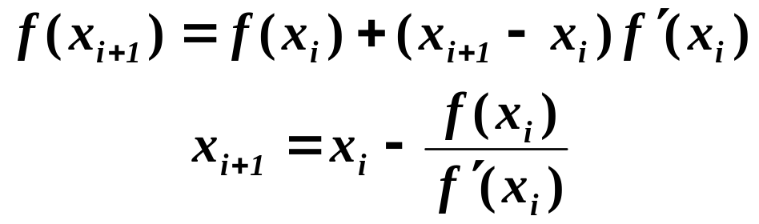
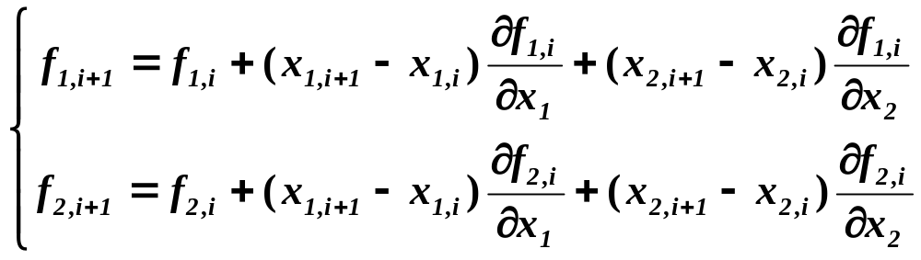
Newton-Raphson Method
One nonlinear equation (Ch.6)
Two nonlinear equations (Taylor-series)

Slide 35
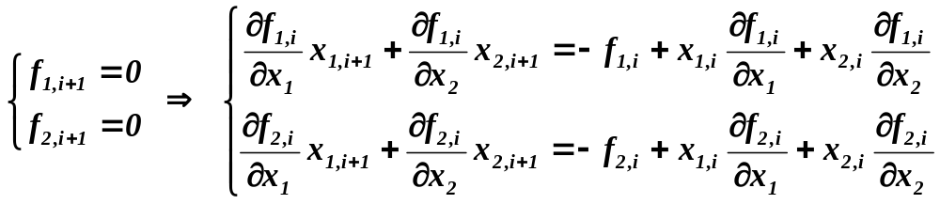
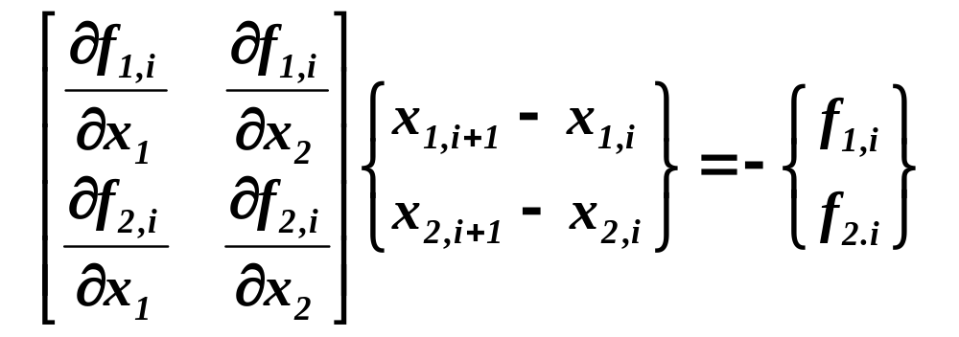
Intersection of Two Curves
Two roots: f₁(x₁,x₂) = 0 , f₂ (x₁,x₂) = 0
Alternatively
[J]{Δx} = −{ f }
Jacobian matrix

Slide 36
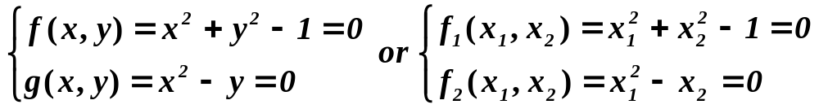
Intersection of Two Curves
Intersection of a circle and a parabola

Slide 37
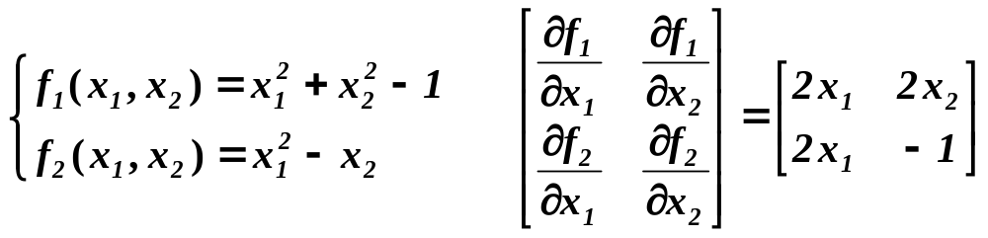
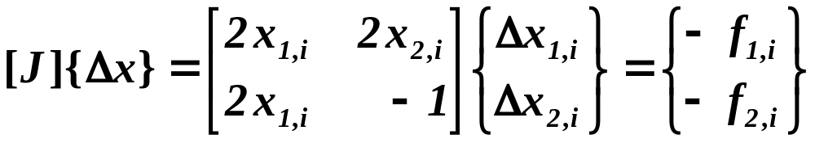

Intersection of Two Curves
Solve for x^{new}

Slide 38

function [x,y,z]=ellipse(a,b,c,imax,jmax)
for i=1:imax+1
theta=2*pi*(i-1)/imax;
for j=1:jmax+1
phi=2*pi*(j-1)/jmax;
x(i,j)=a*cos(theta);
y(i,j)=b*sin(theta)*cos(phi);
z(i,j)=c*sin(theta)*sin(phi);
end
end
» a=3; b=2; c=1; imax=50; jmax=50;
» [x,y,z]=ellipse(a,b,c,imax,jmax);
» surf(x,y,z); axis equal;
» print -djpeg100 ellipse.jpg

Slide 39
function
[x,y,z]=parabola(a,b,c,imax,jmax)
% z=a*x^2+b*y^2+c
for i=1:imax+1
xi=-2+4*(i-1)/imax;
for j=1:jmax
eta=-2+4*(j-1)/jmax;
x(i,j)=xi;
y(i,j)=eta;
z(i,j)=a*x(i,j)^2+b*y(i,j)^2+c;
end
end
Parabolic or Hyperbolic Surfaces
» a=0.5; b=-1; c=1; imax=50; jmax=50;
» [x2,y2,z2]=parabola(a,b,c,imax,jmax);
» surf(x2,y2,z2); axis equal;
» a=3; b=2; c=1; imax=50; jmax=50;
» [x1,y1,z1]=ellipse(a,b,c,imax,jmax);
» surf(x1,y1,z1); hold on; surf(x2,y2,z2); axis equal;
» print -djpeg100 parabola.jpg

Slide 40

Intersection of two nonlinear surfaces
Infinite many solutions

Slide 41

Intersection of three nonlinear surfaces
» [x1,y1,z1]=ellipse(2,2,2,50,50);
» [x2,y2,z2]=ellipse(3,2,1,50,50);
» [x3,y3,z3]=parabola(-0.5,0.5,-0.5,30,30);
» surf(x1,y1,z1); hold on; surf(x2,y2,z2); surf(x3,y3,z3);
» axis equal; view (-30,60);
» print -djpeg100 surf3.jpg

Slide 42


Newton-Raphson Method
n nonlinear equations in n unknowns

Slide 43

Newton-Raphson Method
Jacobian (matrix of partial derivatives)
Newton’s iteration (without inversion)

Slide 44



Newton-Raphson Method
For a single equation with one variable
Newton’s iteration

Slide 45

function x = Newton_sys(F, JF, x0, tol, maxit)
% Solve the nonlinear system F(x) = 0 using Newton's method
% Vectors x and x0 are row vectors (for display purposes)
% function F returns a column vector, [f1(x), ..fn(x)]'
% stop if norm of change in solution vector is less than tol
% solve JF(x) y = - F(x) using Matlab's "backslash operator"
% y = -feval(JF, xold) \ feval(F, xold);
% the next approximate solution is x_new = xold + y';
xold = x0;
disp([0 xold ]);
iter = 1;
while (iter <= maxit)
y= - feval(JF, xold) \ feval(F, xold);
xnew = xold + y';
dif = norm(xnew - xold);
disp([iter xnew dif]);
if dif <= tol
x = xnew;
disp('Newton method has converged')
return;
else
xold = xnew;
end
iter = iter + 1;
end
disp('Newton method did not converge')
x=xnew;

Slide 46
Intersection of Circle and Parabola
function f = ex11_1(x)
f = [(x(1)^2 + x(2)^2 -1)
(x(1)^2 - x(2)) ];
function df = ex11_1_j(x)
df = [2*x(1) 2*x(2)
2*x(1) -1 ] ;
Use x0 = [0.5 0.5] as initial estimates
» x0=[0.5 0.5]; tol=1.e-6; maxit=100;
» x=Newton_sys('ex11_1','ex11_1_j',x0,tol,maxit);
0 0.5000 0.5000
1.0000 0.8750 0.6250 0.3953
2.0000 0.7907 0.6181 0.0846
3.0000 0.7862 0.6180 0.0045
4.0000 0.7862 0.6180 0.0000
5.0000 0.7862 0.6180 0.0000
Newton method has converged

Slide 47


Intersection of Three Surfaces
Solve the nonlinear system
Jacobian

Slide 48

Newton-Raphson Method
Solve the nonlinear system
MATLAB function ( y = J⁻¹F )
y = − feval(JF,xold) \ feval(F, xold)

Slide 49
Intersection of Three Surfaces
function f = ex11_2(x)
% Intersection of three surfaces
f = [ (x(1)^2 + x(2)^2 + x(3)^2 - 14)
(x(1)^2 + 2*x(2)^2 - 9)
(x(1) - 3*x(2)^2 + x(3)^2) ];
function df = ex11_2_j(x)
% Jacobian matrix
df = [ 2*x(1) 2*x(2) 2*x(3)
2*x(1) 4*x(2) 0
1 -6*x(2) 2*x(3) ] ;
» x0=[1 1 1]; es=1.e-6; maxit=100;
» x=Newton_sys(‘ex11_2',‘ex11_2_j',x0,es,maxit);
0 1 1 1
1.0000 1.6667 2.1667 4.6667 3.9051
2.0000 1.5641 1.8407 3.2207 1.4858
3.0000 1.5616 1.8115 2.8959 0.3261
4.0000 1.5616 1.8113 2.8777 0.0182
5.0000 1.5616 1.8113 2.8776 0.0001
6.0000 1.5616 1.8113 2.8776 0.0000
Newton method has converged

Slide 50


Fixed-Point Iteration
No need to compute partial derivatives
Convergence Theorem

Slide 51


Example1: Fixed-Point
Solve the nonlinear system
Rearrange (initial guess: x = y = z = 2)

Slide 52
function x = fixed_pt_sys(G, x0, es, maxit)
% Solve the nonlinear system x = G(x) using fixed-point method
% Vectors x and x0 are row vectors (for display purposes)
% function G returns a column vector, [g1(x), ..gn(x)]'
% stop if norm of change in solution vector is less than es
% y = feval(G,xold); the next approximate solution is xnew = y';
disp([0 x0 ]); %display initial estimate
xold = x0;
iter = 1;
while (iter <= maxit)
y = feval(G, xold);
xnew = y';
dif = norm(xnew - xold);
disp([iter xnew dif]);
if dif <= es
x = xnew;
disp('Fixed-point iteration has converged')
return;
else
xold = xnew;
end
iter = iter + 1;
end
disp('Fixed-point iteration did not converge')
x=xnew;

Slide 53
function G = example1(x)
G = [ (-0.02*x(1)^2 - 0.02*x(2)^2 - 0.02*x(3)^2 + 4)
(-0.05*x(1)^2 - 0.05*x(3)^2 + 2.5)
(0.025*x(1)^2 + 0.025*x(2)^2 -1.875) ];
» x0=[0 0 0]; es=1.e-6; maxit=100;
» x=fixed_pt_sys('example1', x0, es, maxit);
0 0 0 0
1.0000 4.0000 2.5000 -1.8750 5.0760
2.0000 3.4847 1.5242 -1.3188 1.2358
3.0000 3.6759 1.8059 -1.5133 0.3921
4.0000 3.6187 1.7099 -1.4557 0.1257
5.0000 3.6372 1.7393 -1.4745 0.0395
6.0000 3.6314 1.7298 -1.4686 0.0126
7.0000 3.6333 1.7328 -1.4705 0.0040
8.0000 3.6327 1.7318 -1.4699 0.0013
9.0000 3.6329 1.7321 -1.4701 0.0004
10.0000 3.6328 1.7321 -1.4700 0.0001
11.0000 3.6328 1.7321 -1.4701 0.0000
12.0000 3.6328 1.7321 -1.4701 0.0000
13.0000 3.6328 1.7321 -1.4701 0.0000
14.0000 3.6328 1.7321 -1.4701 0.0000
15.0000 3.6328 1.7321 -1.4701 0.0000
Fixed-point iteration has converged

Slide 54


Example 2: Fixed-Point
Solve the nonlinear system
Rearrange (initial guess: x = 0, y = 0, z > 0)

Slide 55
function G = example2(x)
G = [ (sqrt(11/x(3)))
(sqrt(47 - x(1)^2) / 3 )
(sqrt(36 - x(1)^2 - 4*x(2)^2) / 3 ) ];
» x0=[0 0 10]; es=0.0001; maxit=500;
» x=fixed_pt_sys(‘example2',x0,es,maxit);
0 0 0 10
1.0000 1.0488 2.2852 2.0000 8.3858
2.0000 2.3452 2.2583 1.2477 1.4991
3.0000 2.9692 2.1473 1.0593 0.6612
4.0000 3.2224 2.0598 0.9854 0.2779
5.0000 3.3411 2.0170 0.9801 0.1263
6.0000 3.3501 1.9955 0.9754 0.0238
7.0000 3.3581 1.9938 0.9916 0.0181
8.0000 3.3307 1.9923 0.9901 0.0275
9.0000 3.3332 1.9974 1.0017 0.0129
10.0000 3.3139 1.9969 0.9962 0.0201
11.0000 3.3230 2.0005 1.0037 0.0124
12.0000 3.3105 1.9988 0.9972 0.0142
13.0000 3.3213 2.0011 1.0033 0.0126
14.0000 3.3112 1.9991 0.9973 0.0120
15.0000 3.3212 2.0010 1.0028 0.0116
16.0000 3.3120 1.9992 0.9974 0.0107
17.0000 3.3209 2.0008 1.0024 0.0103
18.0000 3.3126 1.9992 0.9977 0.0097
19.0000 3.3205 2.0007 1.0022 0.0092
20.0000 3.3130 1.9993 0.9979 0.0087
...
50.0000 3.3159 1.9999 0.9996 0.0017
...
102.0000 3.3166 2.0000 1.0000 0.0001
103.0000 3.3167 2.0000 1.0000 0.0001
Fixed-point iteration has converged

